Slide 1
NOISE POLLUTION MONITORING

Slide 2
GROUP MEMBERS
BHUVANESWARAN. S(leader)
ARUNTHDEVI. M
DIVYA. M
DHIVYA. B
JAYASATHYA. R
KALAIYARASI. E

Slide 3
ABSTRACT
Noise pollution is unwanted sound, it needs to be controlled to make the workplace comfortable.
This chapter analyses noise mathematically and the effects of multiple sources are examined.
Two noises of exactly the same level can have a combined noise level that is 3 dB higher than the individual values.

Slide 4
INTRODUCTION
Noise pollution is considered to be any unwanted or disturbing sound.
That affects the health and well-being of humans and other organisms.
An IoT-based air and sound pollution monitoring system is implemented using a network of sensors, connectivity technologies, and data analytics platforms.
Air quality sensors are deployed in strategic locations to measure pollutant levels such as particulate matter, gases, and volatile organic compounds (VOCs).

Slide 5
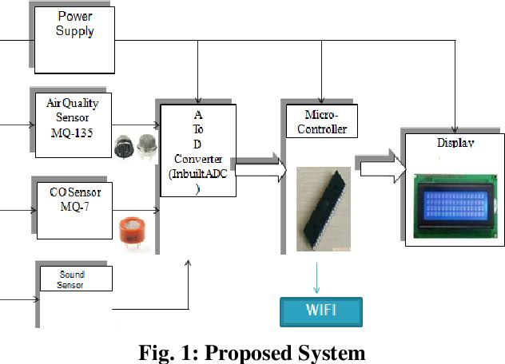
BLOCK DIAGRAM

Slide 6
SOURCES
Noise from Aircraft. ...
Noise from Railroads. ...
Construction Noise. ...
Noise from Industrial Activity. ...
Noise in Buildings. ...
Noise from Consumer Products. ...
Fireworks.

Slide 7
AIR CRAFT NOISE
Aircraft noise pollution refers to noise produced by aircraft in flight.
It has been associated with several negative stress-mediated health effects, from sleep disorders to cardiovascular ones.
Airbus A321 aircraft reported levels of 60-65 decibels (db) before takeoff; 80-85 db during flight; and 75-80 db during landing

Slide 8
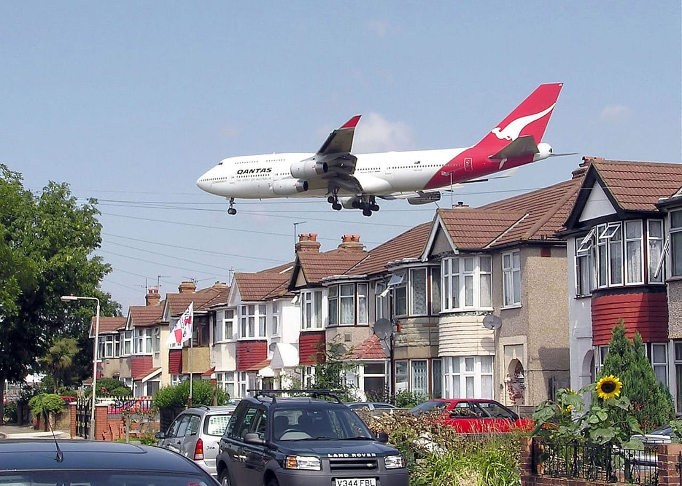
AIR CRAFT DIAGRAM

Slide 9
RAILROADS POLLUTION
Rail transport is a means of transport that transfers passengers and goods on wheeled vehicles running on rails, which are incorporated in tracks.
In contrast to road transport, where the vehicles run on a prepared flat surface
Rail vehicles are directionally guided by the tracks on which they run.

Slide 10
EFFECTS
Noise pollution adversely affects the lives of millions of people.
Studies have shown that there are direct links between noise and health.
Problems related to noise include stress related illnesses, high blood pressure, speech interference, hearing loss, sleep disruption, and lost productivity.

Slide 11
REFLECTING ON NOISE
The most basic sound mitigation technique, noise reflection, uses materials that bounce sound waves away.
The downside of sound reflection is that the sound waves must go somewhere once reflected.
Echoes and sound transference are a by-product of noise reflection.

Slide 12
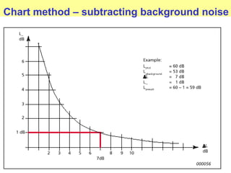
CHART METHOD- NOISE

Slide 13
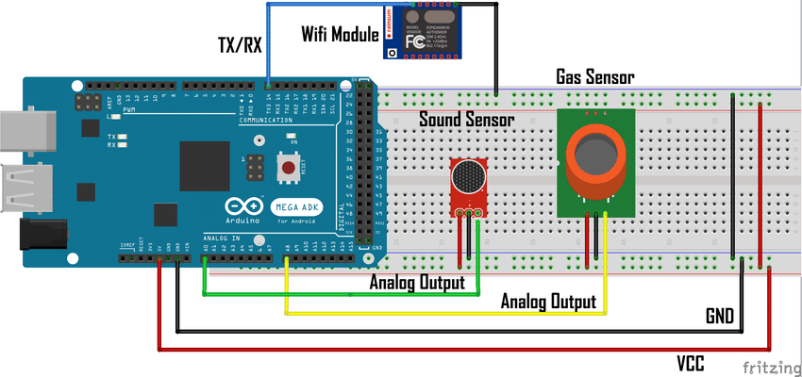
Circuit diagram

Slide 14
DRAW BACKS
Respiratory agitation
Racing pulse
High blood pressure
Headaches
Constant noise
Gastritis
Colitis and even heart attacks.

Slide 15

Program

Slide 16
THANK YOU
.

